Slide 1







Software University
Explore, Learn, Create, Develop
SoftUni Team
Technical Trainers
Software University
http://softuni.bg

Slide 2
Table of Contents
Welcome
Partners
Trainers
Paths and Opportunities

Slide 3
Questions?
sli.do
#fund-common

Slide 4
Welcome to the SoftUni Family
Quality Digital Education for Thousands

Slide 5

Partners

Slide 6

INDEAVR
Business and technology services company
Business Application Development
Infrastructure Services
Collaboration Services
Looking for trainee and junior .NET Developers
https://www.indeavr.com/en/careers

Slide 7

INFRAGISTICS
Providing solutions to accelerate design, development, and collaboration
Design, Development & UX
Angular, JavaScript, ASP.NET, WPF, Xamarin
Bulgaria, USA, England, Japan, Uruguay, India
http://www.infragistics.com/

Slide 8

MOTION SOFTWARE
Development of innovative web projects
40 clients in 15 countries
Financial sector, blockchain, e-commerce, artificial intelligence, big data
Friendly community and availability for 100% remote work

Slide 9

NETPEAK
One of the largest online marketing agencies in Eastern Europe.
Site optimization and online advertising
Bulgaria, Ukraine, Kazakhstan, Russia and USA
https://career.netpeak.bg/

Slide 10


POSTBANK
One of the top banking institutions in Bulgaria
Employer of the Year for 2017
Мember of the Eurobank Group with € 58 billion of assets
Serious investments in digitization
The first bank credit botchat – EVA https://www.facebook.com/evapostbank
Trainee program

Slide 11

SBTECH
Award-winning sports betting solutions
iGAMING PLATFORM
Looking for developers
https://www.sbtech.com/careers

Slide 12

SMARTIT
12 years programming business-orientated solutions
ERP Systems
Mobile iOS & Android
Server Management
Sofia, Plovdiv, Varna and Ruse offices
Looking for .NET developers
https://smartit.bg/en-us/Careers

Slide 13




SOFTWAREGROUP
Integration solutions for financial institutions
Provide digital transformation
Discovering Potential
Driving Innovation
Unlocking Opportunities

Slide 14

SUPERHOSTING
The largest hosting company in Bulgaria
Hosting
Domains
WordPress Hosting
VPS
SSL Certificates
offering a complete solution
top-qualified team
leading technical equipment

Slide 15

TELENOR
Key Areas:
Digital channels
Analytics
UX design
Product development
Software/BI development
Open, adaptive, creative
Hub by Telenor http://www.telenor.bg/careers/youth-vacancies
Notes:
Откриващ слайд
Ние сме Теленор… все още ☺. Официално на 01 август 2018 г. чешкият инвестиционен фонд PPF придоби дружествата Теленор в България, Сърбия, Черна гора и Унгария. В следващите две години ще запазим бранда Теленор.
Промени по стратегията ще има скоро. Със сигурност продължаваме трансформацията от телеком оператор към доставчик на дигитални услуги. И със сигурност няма да сме “mobile only”. Какво означава това ли? Предстои да разберем. Може да е IoT, Smart Homes, Smart Cities or other Automatisation, Analytics as a Service, Banking/Insurance, Video/audio on Demand, Live streaming… you name it.
Фокус все повече ще ни бъдат следните направления:
Digital channels
Analytics
UX design
Product development
Software/BI development
Разпозна ли се? За да сме в крак с времето ще запазим и културата си, в която предложенията идват отдолу и всяко мнение е ценно. Виж какво казва нашето последно изследване на ангажираността сред служителите.
Ако знаеш как да убедиш човек, който има телефон с копчета да ползва смартфон – заповядай при нас. Ако знаеш как да убедиш човек, който има смартфон да го ползва за всевъзможни дигитални услуги, които ще му улеснят живота и спестят време – заповядай при нас. Заповядай при нас, ако имаш идеи, които искаш да реализираш, ние ще ти помогнем. Но помни – реализацията на една идея е 10% креативност и 90% execution или по нашенски – бачкане.
Този месец стартираме и стажантската ни програма Hub by Telenor. Тя е едногодишна, платена и колегите-стажанти работят по реални проекти. Миналата година 9 от 10 от тях останаха при нас за постоянно (10-тата замина за Щатите да си търси късмета ☺). До края на седмицата ще обявим позициите на кариерния ни сайт http://www.telenor.bg/careers/youth-vacancies Не се колебай, влез, избери си и кандидатствай.
Не успяхме да ти кажем всичко. А ако ти предпочиташ личния контакт - на 28-29.09 ще бъдем на SoftUnit конференцията. Ела и ще се запознаеш с нашите колеги на щанда ни или ще чуеш лекторите ни на тема “Analytics Enablers for Business: Contextual Marketing Platform”. Ще говорят за нещо, което предстои да пуснем следващата седмица – една от най-актуалните теми за нас в момента.

Slide 16




XS SOFTWARE
Gaming company founded back in 2005 in Sofia
Introduced the first browser games in Bulgaria
Over 50,000,000 registered players
Looking for PHP Game Dev

Slide 17

STEMO
Implementation of software solutions:
Consultants, business analysts, administrators and developers, quality assurance and support specialists, project managers
Microsoft .NET, Java EE, Delphi, Mobile (Android), Web (JavaScript, Angular JS, HTML, CSS)
https://stemo.bg/en/software-house

Slide 18

SoftUni Diamond Partners

Slide 19




SoftUni Organizational Partners

Slide 20

The Trainers

Slide 21
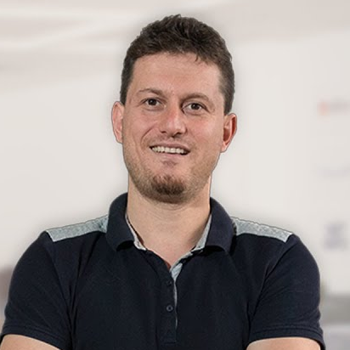
Svetlin Nakov
Co-Founder of Software University
Training & Inspiration Manager @ Software University (SoftUni)
20+ years as software developer
10+ years experience as trainer
Author of 8 programming books
Speaker at hundreds of events
Web site & blog: www.nakov.com

Slide 22
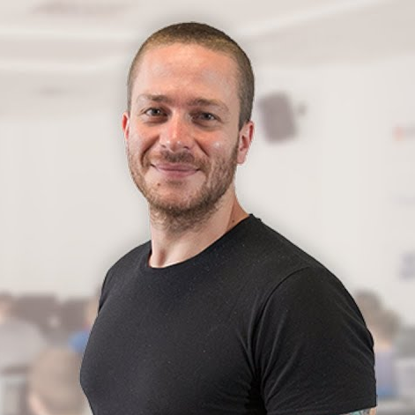
Ivaylo Kenov
Various job titles at the same time:
Mathematical competitions champion
Full Stack Technical Trainer
Senior Software Developer
Solution Architect & Technical Lead
One-man army @ My Tested ASP.NET
Contacts:
https://github.com/ivaylokenov
https://facebook.com/ivaylo.kenov
https://linkedin.com/in/kenov

Slide 23
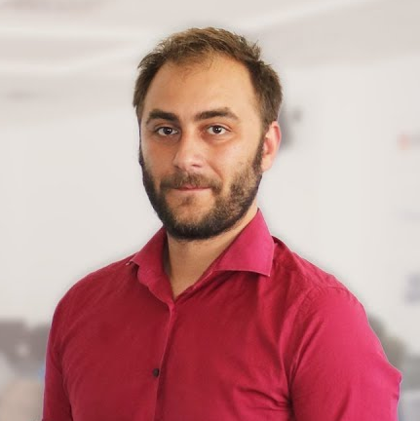
Doncho Minkov
Senior Full Stack Developer in SoftUni
10+ years in IT
8+ years of experience as a Technical Trainer in Telerik Academy
Front-end developer by heart
Software developer by need
Experience with all popular mobile platforms
Android, iOS, Windows
Fluent in Node.js, .NET, Angular, Java, C++
"30 under 30" – Forbes 2017 - Education

Slide 24
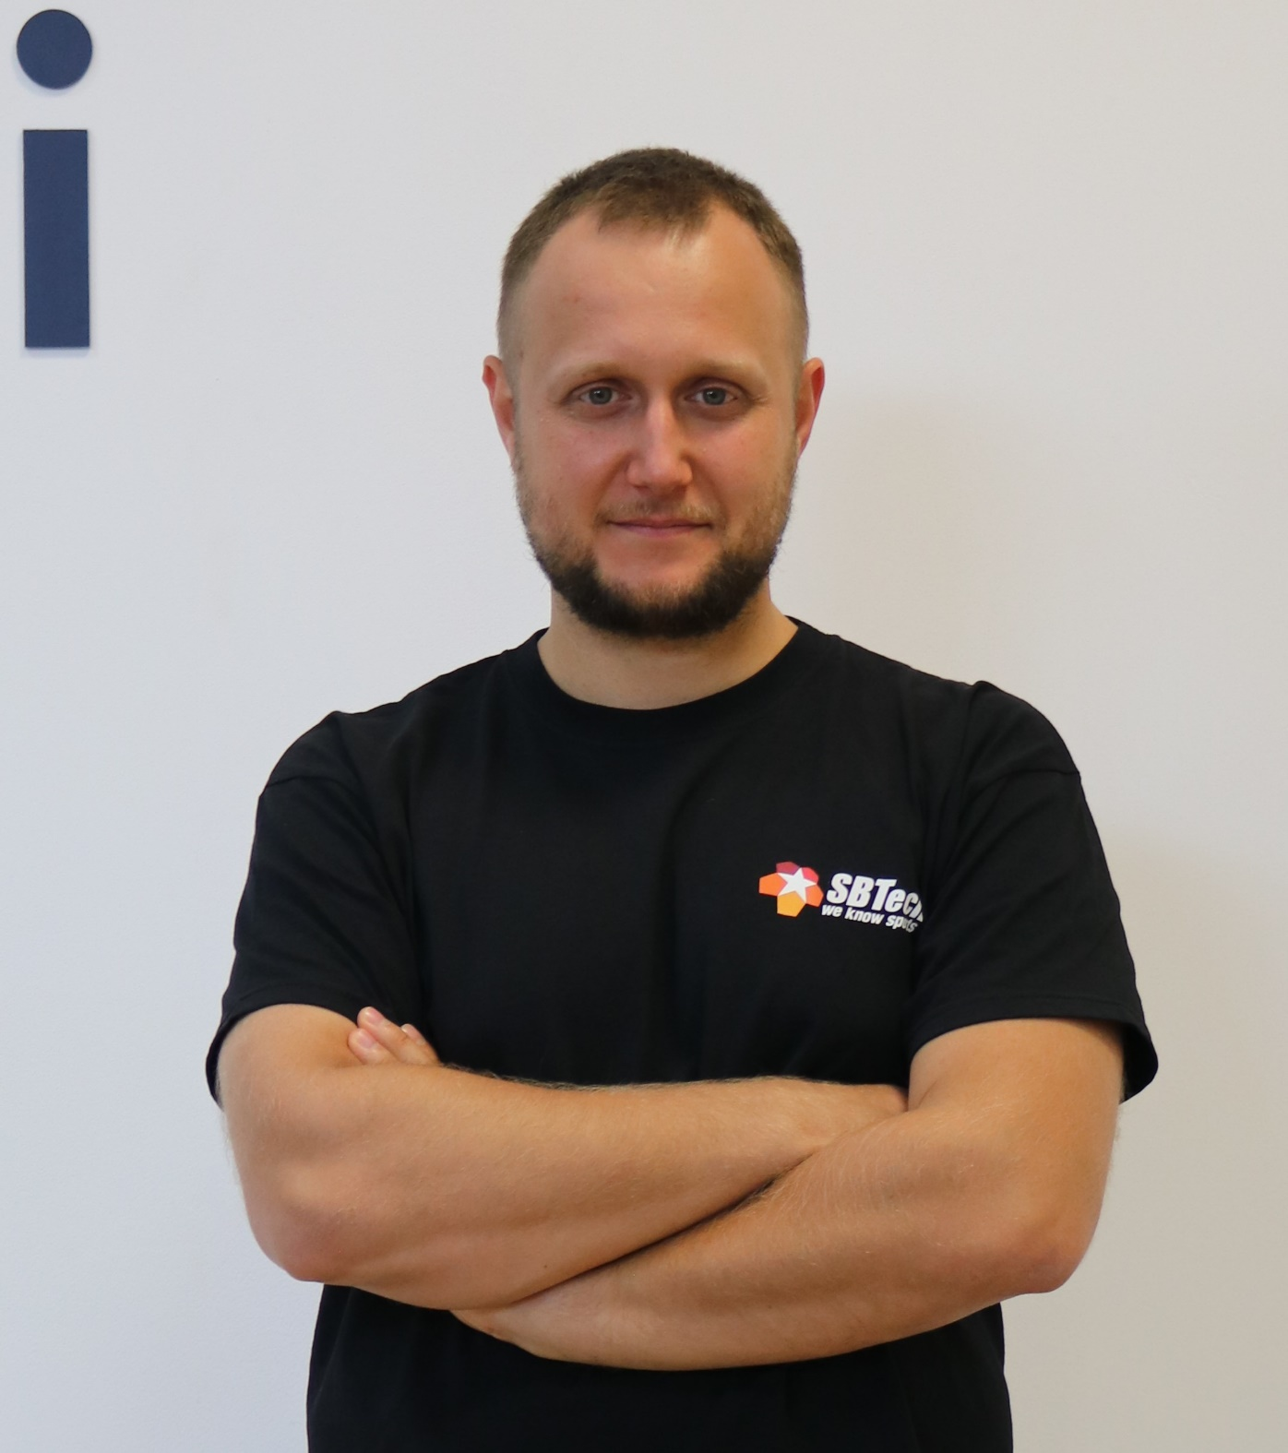
Martin Chaov
Technical Lead and Software Architect @ SBTech
Specialist in client software and JavaScript programming
His main task is to maintain and develop the SBTech end-user application architecture
This includes responsive web applications, PWAs, native apps and more

Slide 25
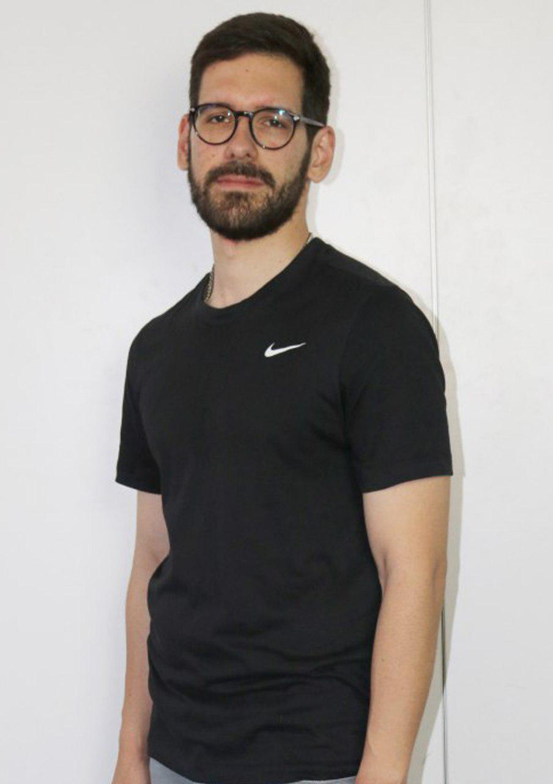
Ilia Idakiev
Software developer-entrepreneur
Google Developer Expert
Co-organizer of Angular Sofia and SofiaJS / BeerJS
Lecturer at Sofia University (FMI)
"Advanced JavaScript" course

Slide 26
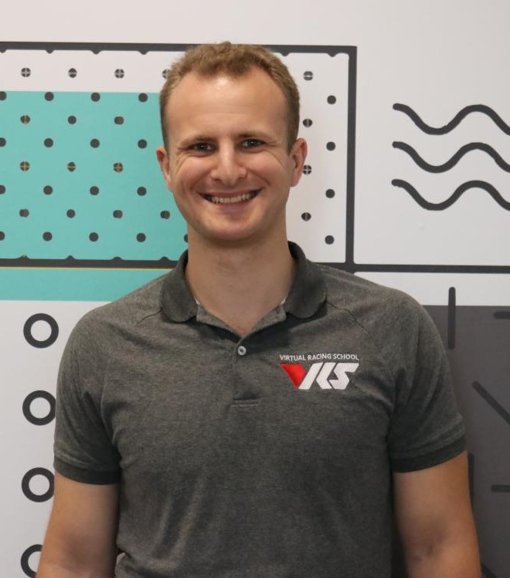
Georgi Georgiev
Technical trainer @ SoftUni
C++, C#, Java, Data Structures and others
Developer @ VirtualRacingSchool.com
Java, JavaScript, C++
Experience
4+ years training, 10+ years coding
Wrote a driving simulator once in high school (DriveFreeZ award)
Played around with OpenGL, Bullet Physics SDK, WinRT

Slide 27
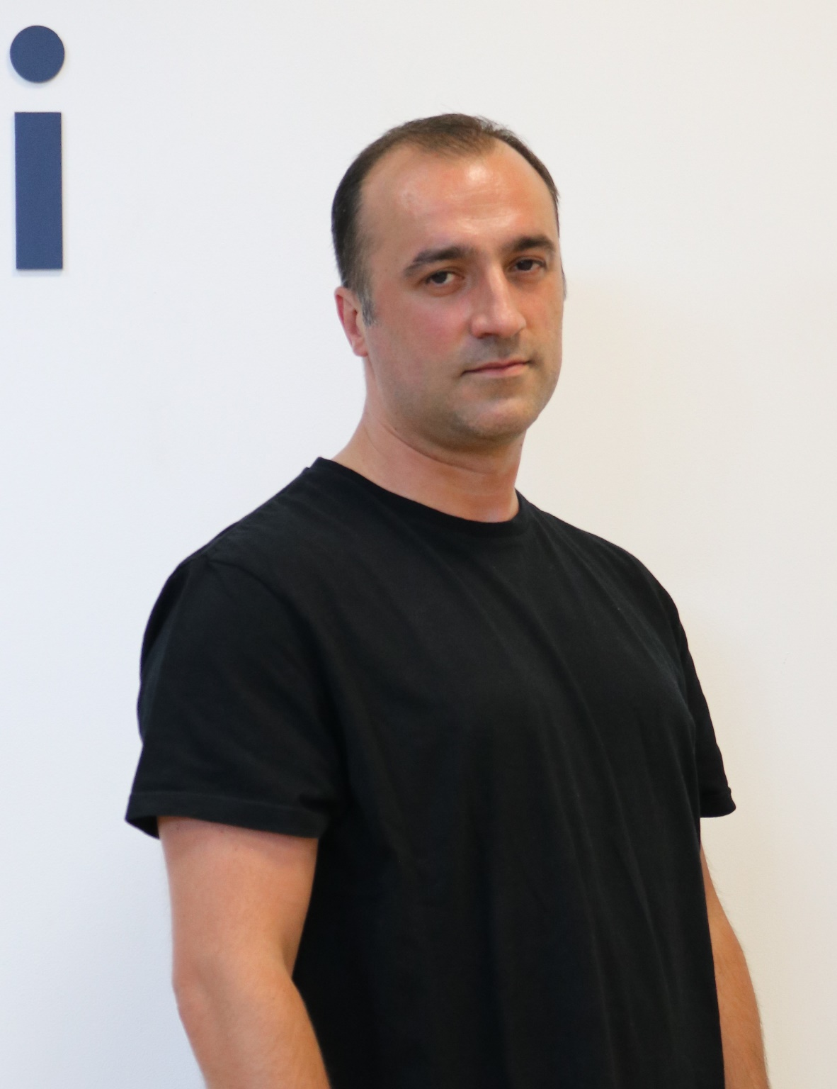
Dobri Stoilov
Has Master Degree in Applied Mathematics
Works in the IT industry since year 2000
Works with Python since year 2009
Since 2014 works as a senior Python Web developer
Has many successful projects in the area of web applications and machine learning

Slide 28
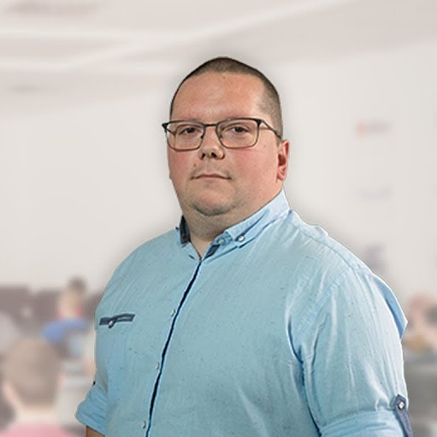
Konstantin Dankov
Product Manager @ Historypin
17+ years working with HTML & CSS
Working as a front end developer since he`s 18
Likes the need for attention to the detail

Slide 29
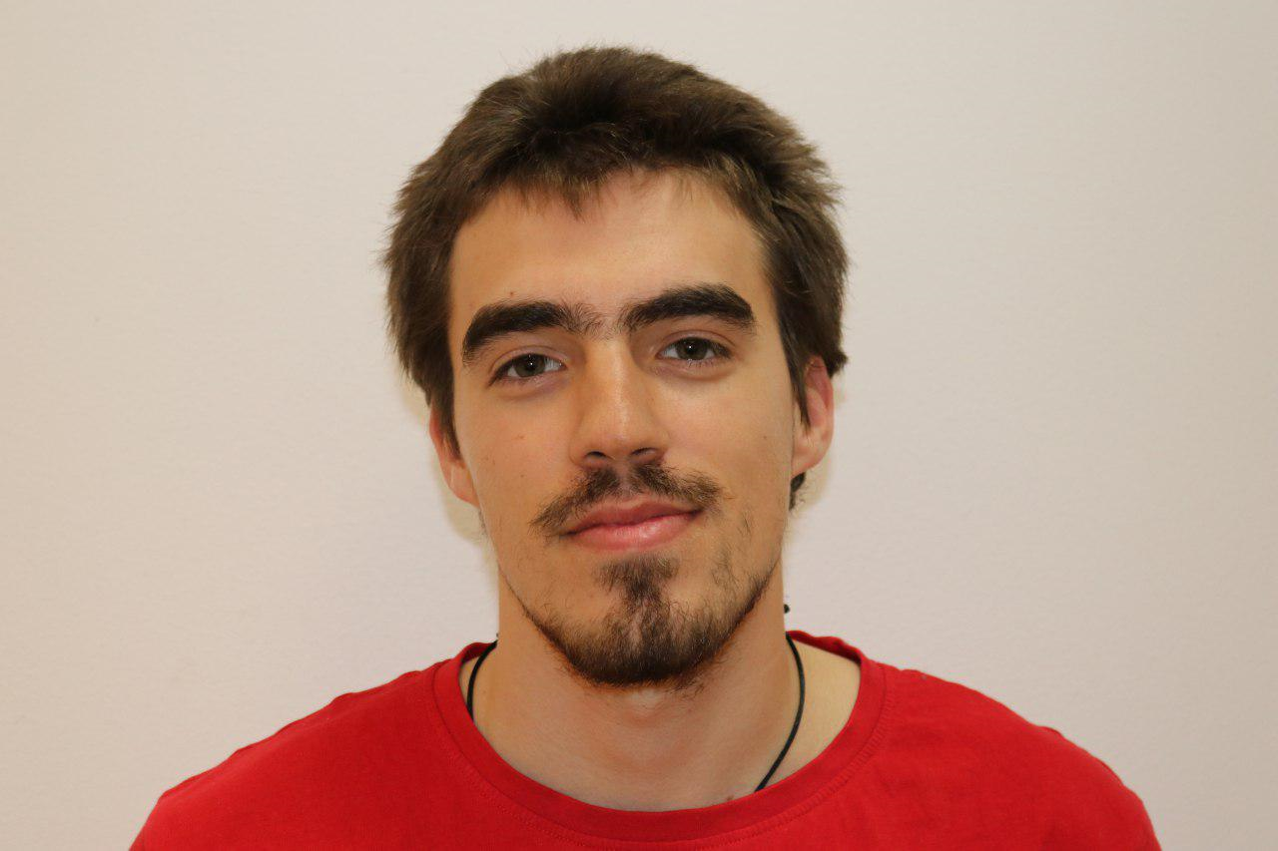
Nikolay Bankin
Software Engineer with 6 years of experience with various technologies
Bachelor of Informatics
Teacher at TUES
5 years of experience as a Trainer

Slide 30

Nikolay Kostov
Solutions Architect @ ZenCodeo
15+ years in IT
Takes an active role in the development of the https://judge.softuni.bg/
Microsoft Certified Trainer
http://nikolay.it/

Slide 31
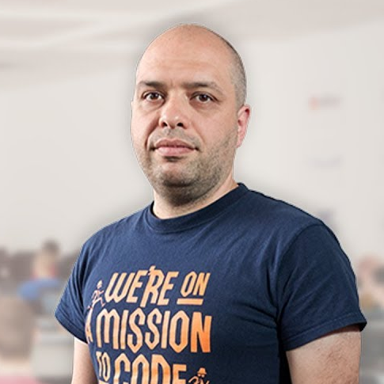
Stamo Petkov
Head Of Department at Information Services Plc.
Worked with various technologies
.NET and C#, BASIC, Pascal, Object Pascal, PHP
More than 15 years of experience
Experienced Technical Trainer

Slide 32
INFORMATION SERVICES
Key partner of the state institutions in the implementation of ICT projects
The Ministry of Finance
The National Revenue Agency
The Customs Agency
The Ministry of Regional Development and Public Works
The first governmentally approved provider of qualified certification services in Bulgaria
https://www.is-bg.net/bg/

Slide 33
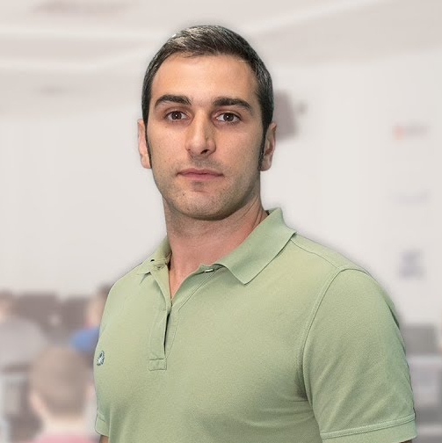
Radi Atanasov
Chief SharePoint Architect, Owner @ OneBit Software
Achieved two of highest degrees of technology certification
Microsoft Certified Master
Microsoft Certified Solution Master
External consultant at "Office 365 Developer Patterns & Practices Core Team" at Microsoft Redmond

Slide 34
ONEBIT SOFTWARE
Software development and consulting company
Heavy involvement with the Microsoft SharePoint platform
Winning and delivering some of the best SharePoint projects
OneBit Survey Master
OneBit Quick Poll
https://www.onebitsoftware.net/

Slide 35

Path and Opportunities
The choice is yours

Slide 36
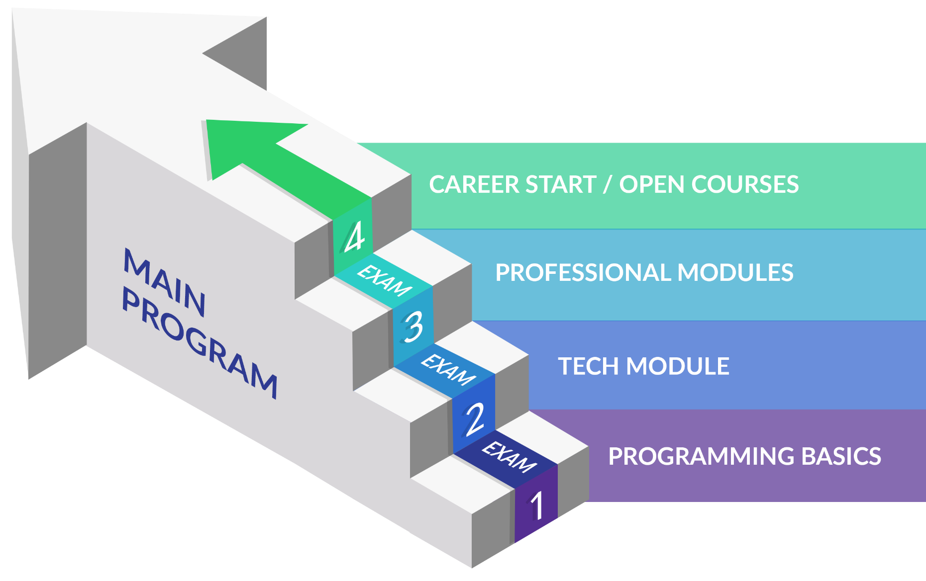
Internal Program
C#, Java, PHP, JavaScript

Slide 37
Curriculum
Entry Module
Programming Basics
2 months
Fundamental Module
Fundamentals Module
4 months
Professional Modules
Java
C#
Python
JS
8-16 months

Slide 38

Trainee Program

Slide 39
https://softuni.bg/trainings/courses

Slide 40
SoftUni Diamond Partners

Slide 41
SoftUni Organizational Partners

Slide 42




Trainings @ Software University (SoftUni)
Software University – High-Quality Education and Employment Opportunities
softuni.bg
Software University Foundation
http://softuni.foundation/
Software University @ Facebook
facebook.com/SoftwareUniversity
Software University Forums
forum.softuni.bg

Slide 43

License
This course (slides, examples, demos, videos, homework, etc.) is licensed under the "Creative Commons Attribution-NonCommercial-ShareAlike 4.0 International" license

